Slide 1



Home
About Us
Contact Us
aasta
Be Our Investor
JOIN US TO REVOLUTIONIZE
THE WAY YOU SEE
“FOOD WASTE”

Slide 2


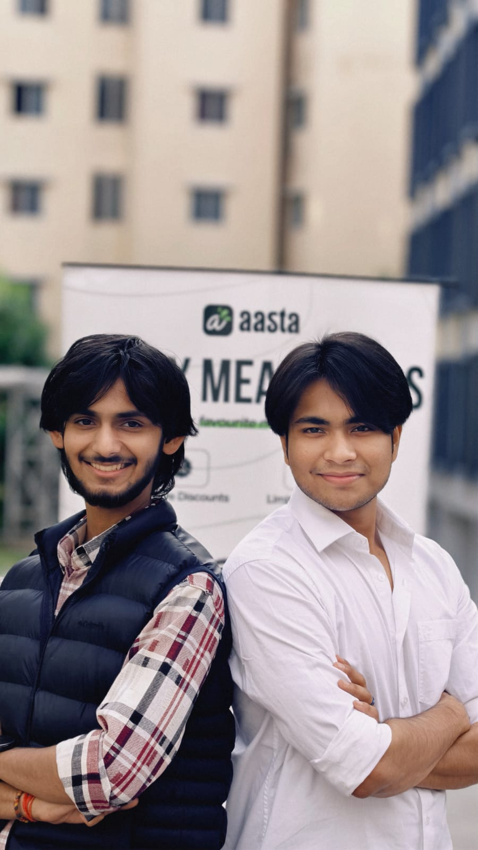
Students of
We are Creating “The next big thing”
A Message from the Students of “PW IOI”
What we’re building has never been done before in India— but we’ve already beaten the odds.
An idea that makes your inner self happy, that makes sense to the heart and to the world: A platform that is helping restaurants, cafés, catering services, and vendors to sell their extra-unsold food. At huge discounts, and making that food accessible to people who need it most - students, gig workers, and hustlers, Looking to eat with no money in their pocket.
We need you - your help to make it reach every corner of India.
We can’t promise success - no one can - but we can promise that we’ll put everything we have into making “Aasta” one of the most meaningful and scalable food innovations this country has seen.
Our vision is to become India’s leading force against food wastage - Crafting policies, creating awareness, and partnering with the government to redefine food wastage and how India thinks about it.
Because if we succeed, It won’t just be our victory - it’ll be India’s win against food waste, hunger, and inefficiency.
Thank you for believing in us.
If you see what we see, and feel what we feel - then join us.
We’re inviting you to become part of a revolution.
Onward and Upward,
Team Aasta 💚

Slide 3
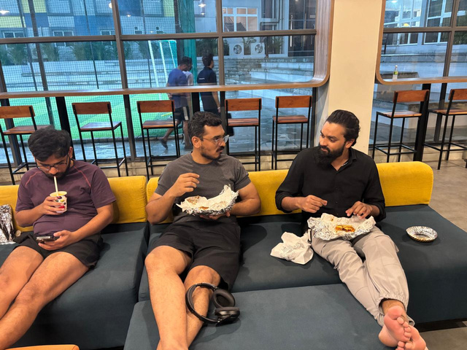
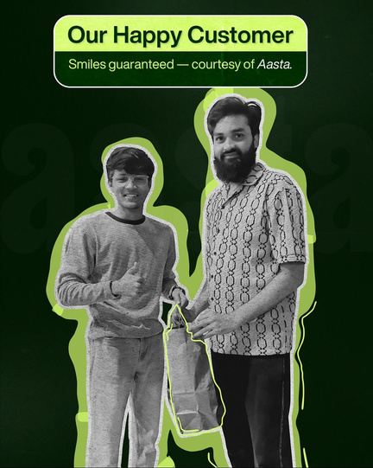
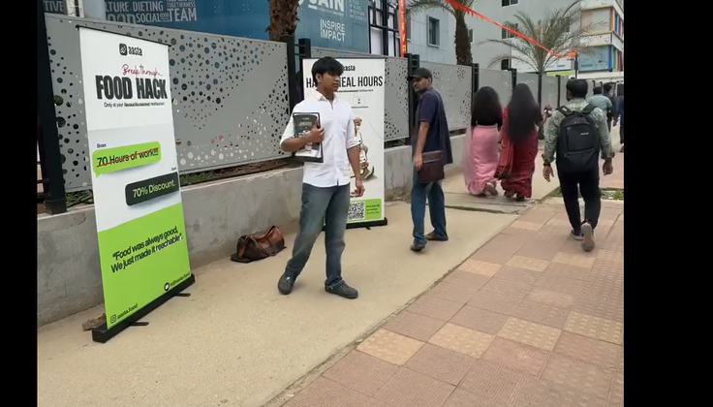
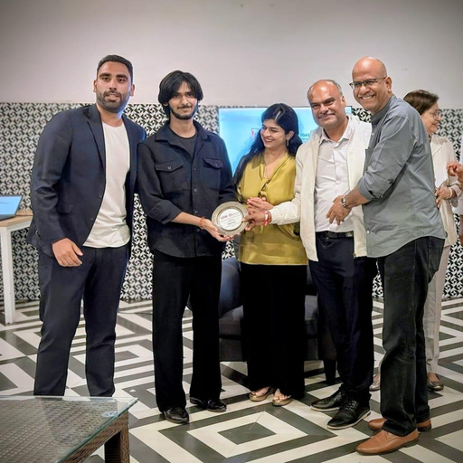
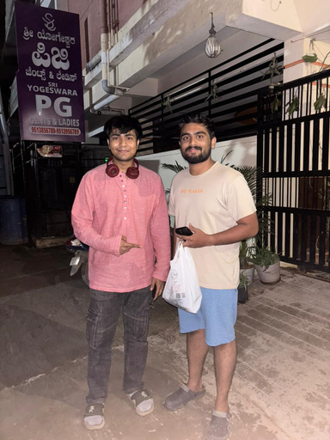
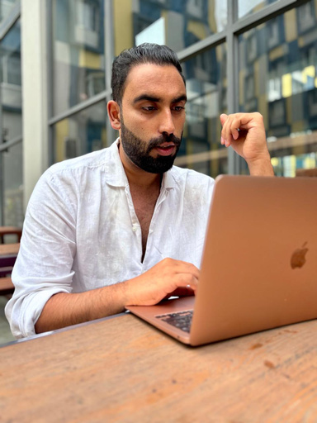



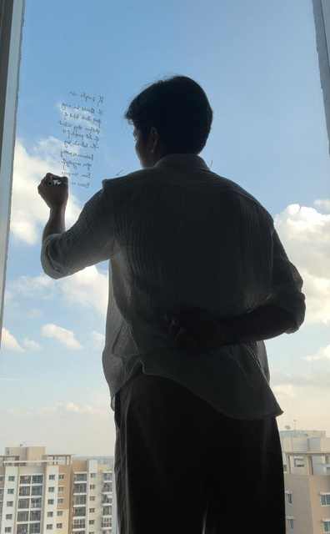
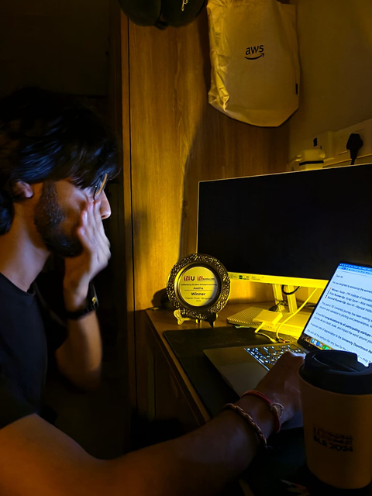
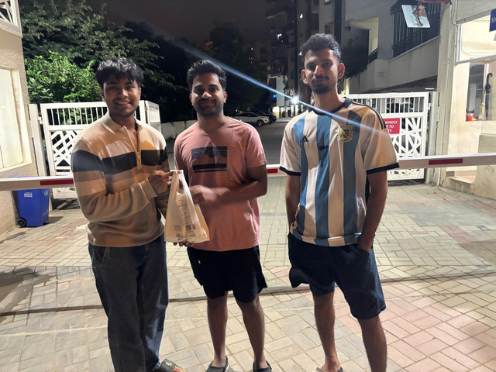

aasta
A FoodHack Platform Under Making

Slide 4
₹92,000cr - 1.5L cr/year wasted*
in the Industry
₹1.5 lakh Crore value of Food Get Wasted.
Over 20% is Consumable in (HoReCa) Industry
₹30,000 cr
TAM
₹30,000 crore is monetizable
₹25,000 cr+
Avg 25,000 Restaurants, Bakeries, Supermarkets etc. Per city × ₹10K/month avrg surplus food, /Year.
₹240 Cr
SAM
10 metro Cities
20,000 restaurants (BANG) × ₹10K monthly surplus = ₹200 crore/year
SOM
Start with Bangalore
Be Part of the Revolution

Slide 5


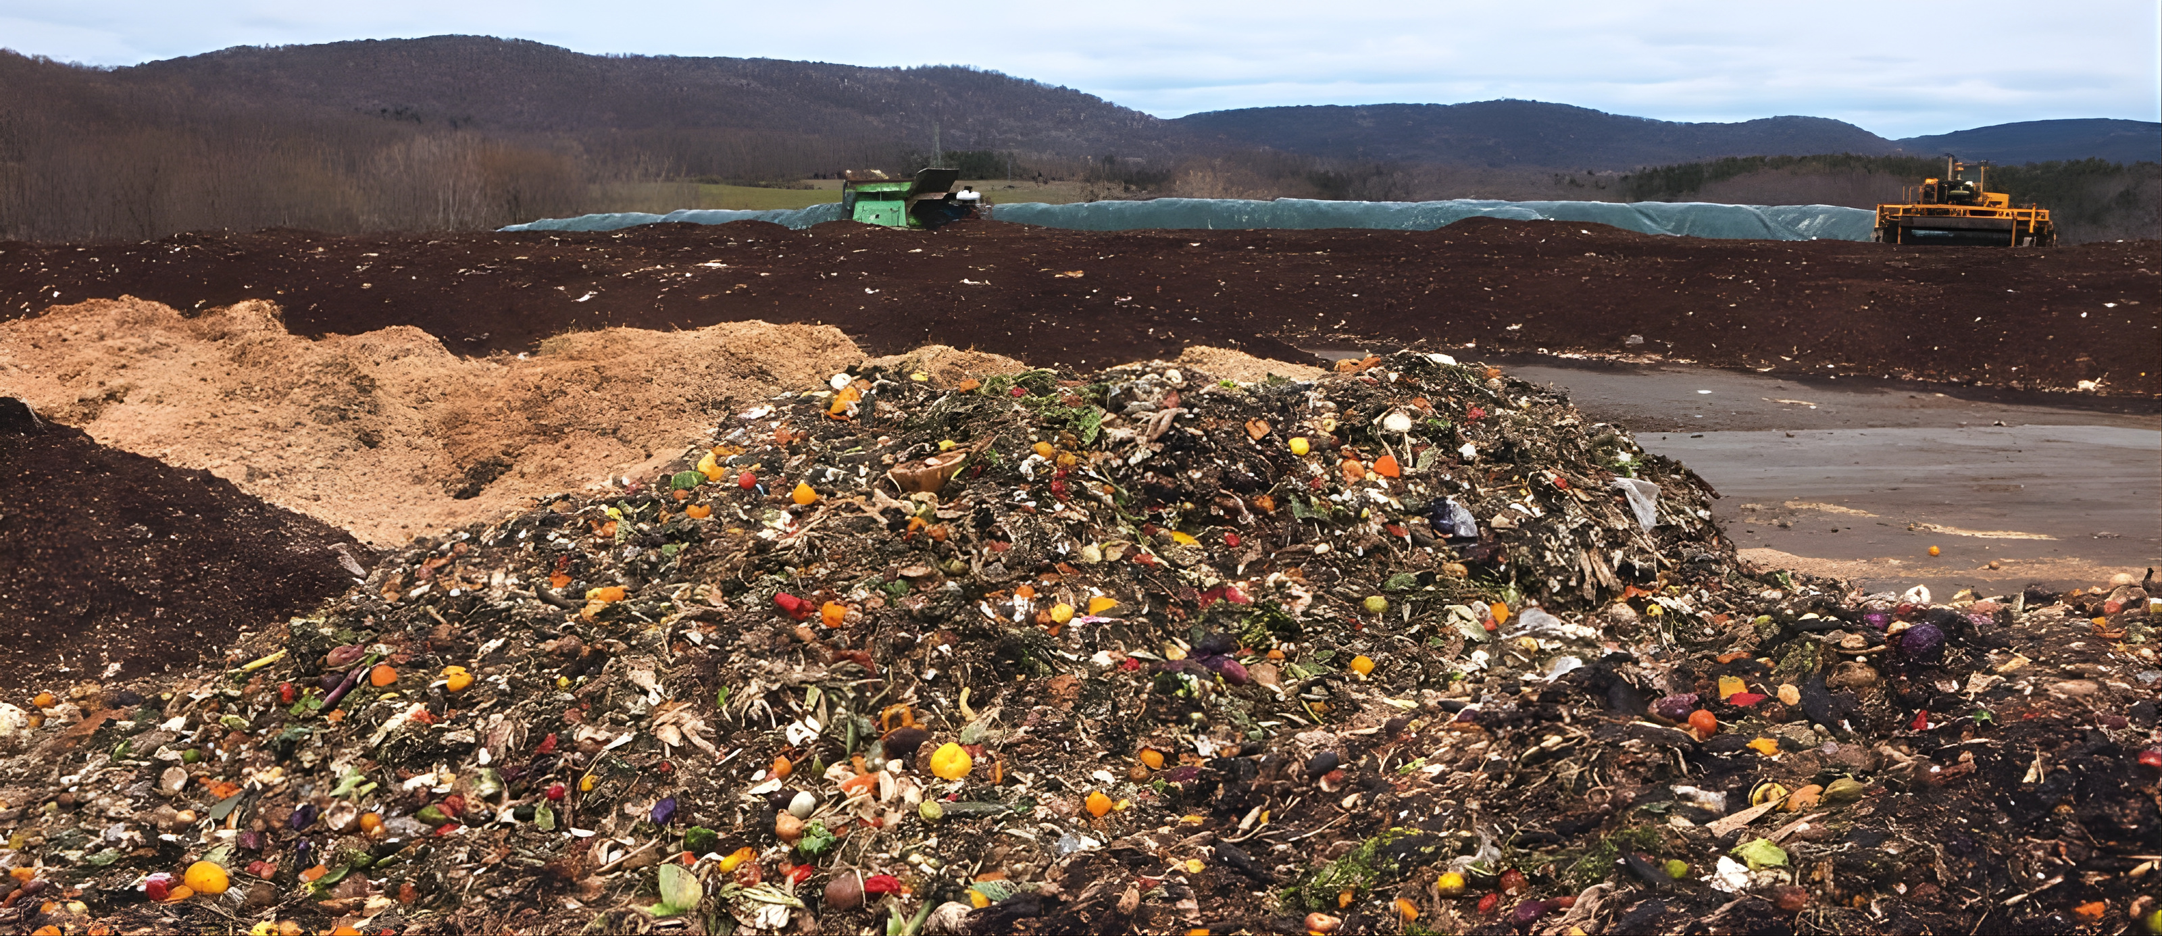
75% of food wastage produced in the food sector is perfectly edible before disposal. (WRAP)
Aasta Goal is to Monetize this.

Slide 6

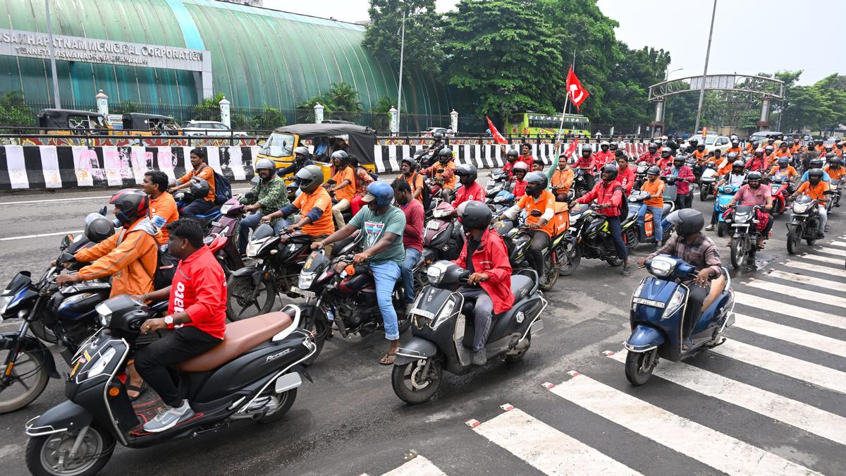
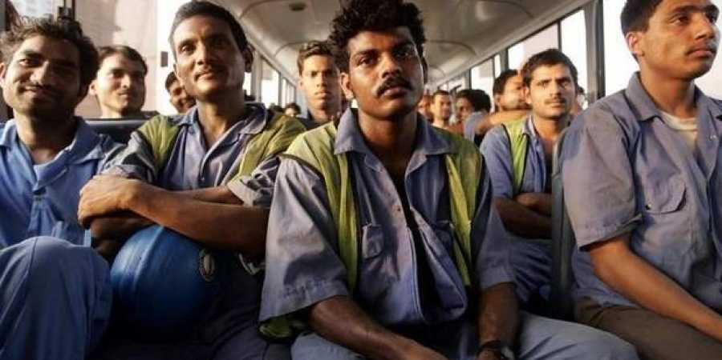
Low-income and working-class consumers in India rarely use Swiggy or Zomato due to high prices .
Aasta Goal is to Monetize this.

Slide 7





Revenue Model
Commisions from restaurants
10-15% comissions on each order
Brand Partnerships
FMCG / F&B brands sponsor Products
Surprise Meal
BOX
Mystery meal at
discount/for Gen-z
Audience
Platform Fee from Customer’s
Flat Rs.6 Per Order
Featured Placements (Restaurant)
Restaurants Pay for top placements
Subscription Model
Customer’s Pre-Book Deals
Aasta plans to turn binned food waste into fertilizers and sustainability.

Slide 8

We are inviting “you” to
Join “Aasta“
₹15
₹4.5M
10,000
3-4
Revenue Per Order
Monthly Revenue Potential
Target- Daily Customer
Timeline to ₹10M
Net earning per order
₹15 × 10,000 orders/day × 30 days
Customers per day
4 Months at ₹4.5M/month to reach ₹10M

